Slide 1
Beginning Database Design
Chapter 01

Slide 2
Mishandling Keywords and Categories
A common problem in database design is the failure to properly deal with keywords and categories.
When entering data, you usually think of an item with its particular list of categories or keywords.
However, when you come to preparing reports or doing some analyses, you may need to look at things the other way around.

Slide 3
You often want to see a category with a list of all its items or a count of the number of items.
For example, you might ask, “What percentage of our customers is in the high–income bracket?”
If keywords and categories are not stored correctly initially, these reports can become very difficult to produce.

Slide 4
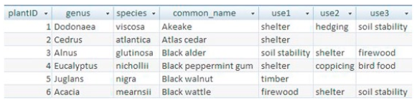
example 1-1. the plant Database
shows a small portion of a database table recording information about plants. Along with the botanical and common names of each plant, the developer decides it would be convenient to keep information on the uses for each plant. This is to help prospective buyers decide whether a plant is appropriate for their requirements.

Slide 5
example 1-1. the plant Database
If we look up a plant, we can immediately see what its uses are. However, if we want to find all the plants suitable for hedging, for example, we have a problem. We need to search through each of the use columns individually. Producing a report of all hedging plants would require some logic along the lines of: “IF use1 = ‘hedging’ OR use2 = ‘hedging’ OR use3=‘hedging’.”

Slide 6
example 1-1. the plant Database
Also, the database table as it stands restricts a plant to having three uses. That may be adequate for now, but if that three–use limit changes, the table would have to be redesigned to include a new column(s). Any logic will need to be altered to include “OR use4=‘hedging’,”

Slide 7
In Example 1-1, the real shame is that all the data has been carefully collected and entered, but the design of the table makes it extremely difficult to answer a question such as, “What plants are good for shelter?” The developer has done better than many in separating the uses into individual columns.

Slide 8
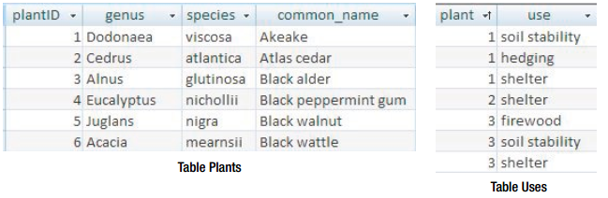
Jumping ahead a bit to see a solution for the plant database problem, you can quite quickly set up a useful relational database by creating the two tables shown in Figure 1-2. (Some extra tables would be even better, but more about that in Chapter 2.)

Slide 9
An end user with modest database skills would be able to set up the appropriate keys, relationships, and joins and produce some useful reports. A simple query on (or even a filtering or sorting of) the Uses table will enable the user to find, for example, all shelter plants.
There is no restriction now on how many uses a plant can have.
The initial setup is slightly more costly, in time and expertise, than for the single table described in Example 1-1, but these separate tables will be able to provide a great deal of additional information.

Slide 10
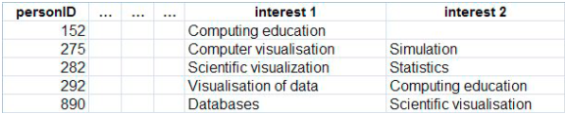
example 1-2. research Interests
An employee of a university’s liaison team often receives calls asking to speak to a specialist in a particular topic.
The liaison team decides to set up a small spreadsheet to maintain data about each staff member’s main research interests.
originally, the intention is to record just one main area for each staff member, but academics, being what they are, cannot be so constrained.
The problem of an indeterminate number of interests is solved by adding a few extra columns in order to accommodate all the interests each staff member supplies.
Part of the spreadsheet is shown :

Slide 11
We are able to see at a glance the research interests of a particular person, but as was the case in Example 1-1, it is awkward to do the reverse and find who is interested in a particular topic.
However, we have an additional problem here.
Many of the research interests look similar but they are described differently. How easy will it be to find a researcher who is able to “visualize data”?

Slide 12
The table has been designed taking just one class of data into consideration: in this case, People. Really, though, we have two classes, People and Interests, and we are concerned with the connections or relationships between them.
Creating a table of people is reasonably straightforward, but the table of interests poses some problems.
What are the different possible
research interests in Example 1-2?

Slide 13
The answer is not so obvious. A quick glance at the data displayed shows eight interests, but it is reasonable to assume that “visualisation” and “visualization” are merely different spellings of the same topic. But what about “scientific visualisation” and “visualisation of data”—are these the same in the context of the problem? What about computer visualisation”? Any staff member with one of these interests would probably be useful for an outside inquiry about how to visualize some data.

Slide 14
Having decided on two classes of data, People and Interests, we now need to clearly define what we mean by them.
People isn’t too difficult—you might have to think about which staff members are to be involved and whether postgraduate students should also be included.
However, Interests is more difficult. In the current example, an interest is anything that a staff member might think of.

Slide 15
Repeated Information
Another common problem is unnecessarily storing the same piece of information several times. Such redundancy is often a result of the database design reflecting some sort of input form.
For example, in a small business, each order form may record the associated information of a customer’s name, address, and phone umber. If we design a table that reflects such a form, the customer’s name, address, and phone number are recorded every time an order is placed. This inevitably leads to inconsistencies and problems, especially when the customer moves from one address to another.
We might want to send out an advertising catalog, and there will be uncertainty as to which address should be used. Sometimes the repeated information is not quite so obvious. Example 1-3 illustrates one such case.

Slide 16
example 1-3. Insect Data
Team members of a long-term environmental project regularly visit farms and take samples to determine the numbers of particular insect species present. Each field on a farm has been given a unique code, and on each visit to a field a number of representative samples are taken. The counts of each species present in each sample are recorded.

Slide 17
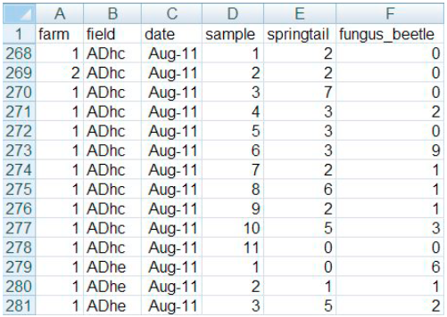
The information about each farm was recorded (quite correctly) elsewhere, thus avoiding that data being repeated. However, there are still problems. The fact that field ADhc is on farm 1 is recorded every visit, and it does not take long to find the first data entry error in row 269. (The coding used for the fields raises other issues that we will not address just now.)

Slide 18
It is important to distinguish the difference between data input errors (anyone can make typos now and then) and design errors. but that the association between farm and field was recorded so many times that an eventual error became almost certain.

Slide 19
Another piece of information is also repeated in the spreadsheet in Example 1-3: the date of a visit. The information that field ADhc was visited on Aug-11 is repeated in rows 268 to 278, creating another source of avoidable errors (e.g., we could accidentally put Aug-10 in row 273). Such an error would affect any analyses based on date.

Slide 20
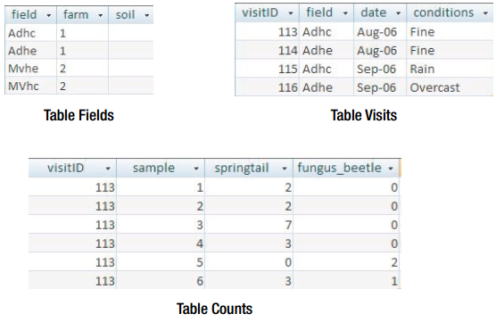
Rather than thinking of the data in terms of the counts in each sample, the designer would have
thought about Farms, Fields, Visits, and Insects as separate classes of data in which researchers are interested both individually and together.

Slide 21
Designing for a Single Report
Another cause of a problematic database is to design a table to match the requirements of a particular report. A small business might have in mind a format that is required for an invoice.
A school secretary may want to see the whereabouts of teachers during the week. Thinking backward from one specific report can lead to a database with many flaws.

Slide 22
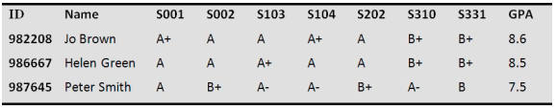
example 1-4. academic results
A university department needs to have its final–year results in a format appropriate for taking along to the examiners’ meeting. The course was very rigidly prescribed with all students completing the same subjects, and a report similar to the one in Figure below was generated by hand prior to the system being computerized. This format allowed each student’s performance to be easily compared across subjects, helping to determine honors’ boundaries.

Slide 23
A database table was designed to exactly match the report in Figure below, with a field for each column. The first year the database worked a treat. The next year the problems started. Can you anticipate them?

Slide 24
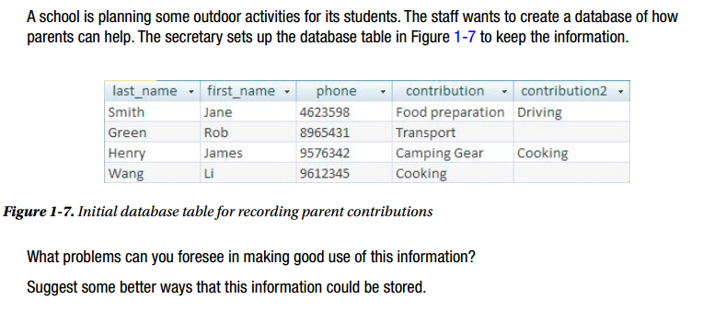
EXERCISE 1-1

Slide 25
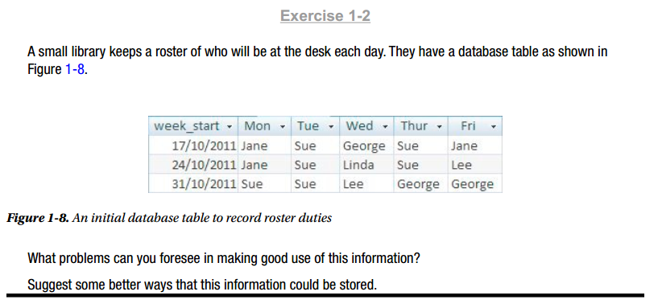
EXERCISE 1-2

